Slide 1
Intrinsic Value Calculator A FinTech Project
By: Aanchal Khanna

Slide 2
Project Overview
A FinTech project to calculate the intrinsic value of a stock using the DCF model.
Objective: To calculate the intrinsic value of a stock.
Scope: Used a very simple (vanilla) implementation of DCF model [from Novus Investing]. Automated and implemented this model using Python and Yahoo Finance.

Slide 3
Data Overview
DCF Model: Used DCF model from Novus Investing
[https://www.youtube.com/@novusinvesting]
Financial Data Source: Yahoo Finance
[https://finance.yahoo.com/]

Slide 4
Research Questions
QUESTION 1 – Is there any difference between intrinsic stock price and market stock price for individual stocks in the S&P 500 market index?
QUESTION 2 – Are the popular tech stocks (MAANG + Tesla) overvalued or undervalued?
QUESTION 3 – What is fundamental analysis? Is it a better approach for trading stocks than technical analysis?

Slide 5
What Discounted Cash Flow (DCF) Modeling?
A DCF is a valuation methodology that measures the intrinsic value of a company based on the sum of present value of its future cash flows.
The first step is to forecast the Free Cash Flows for 5-10 years by making assumptions about the company’s revenue growth and/or EBIT growth. We then calculate the terminal value by using the perpetuity growth method.
We then discount back the projected Free Cash Flows and the Terminal Value using the discount rate (most popularly WACC). The sum of these present values gives us the Enterprise Value, which is used to calculate the intrinsic value per share.

Slide 6
Steps in DCF Model
STEP 1 – Calculate the Weighted Average Cost of Capital (discount rate).
STEP 2 – Project the future Free Cash Flows and the Terminal Value.
STEP 3 – Discount the projected Free Cash Flows and Terminal Value back to find their Present Values.
STEP 4 – Add up all the present values to get the Enterprise Value.
STEP 5 – Subtract the cash and total debt from the Enterprise Value to get the Equity Value.
STEP 6 – Finally divide the equity value by the number of shares outstanding to calculate the Intrinsic Value per share. The Intrinsic Value per share is compared with the Market Price per share to determine if the stock is “overvalued” or “undervalued”.

Slide 7
Weighted Average Cost of Capital
To operate a business, a firm needs money or capital. There are two primary sources from where it gets capital:
From lenders (called debt)
From owners (called equity)
Obtaining capital is not “free”, a firm must pay a cost.
WACC is a firm’s after-tax cost of capital from all sources (both debt and equity).

Slide 8
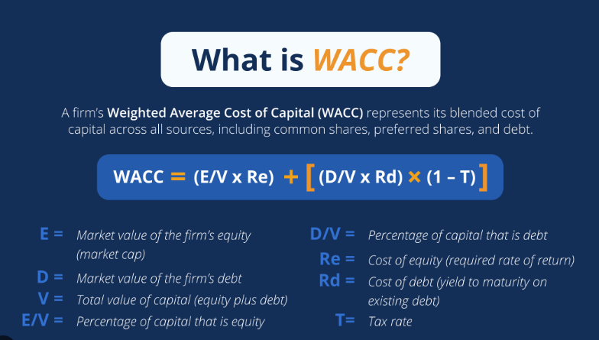
Weighted Average Cost of Capital
Cost of Equity is rate return that firm theoretically pays to its shareholders. Compensation for the risk of investing their capital.
Use Capital Asset Pricing Model
Cost of Debt is rate of return that firm pays to creditors.

Slide 9
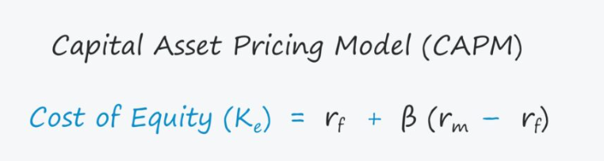
Cost of Equity – CAPM!
CAPM is the Capital Asset Pricing Model
Rf = Risk-free rate of return, usually 10-year yield of US Treasury Bond
B = Beta of the stock, measures the co-movement of the stock and the overall market (S&P 500)
Rm = Expected market return (avg. return of 8% for S&P 500)

Slide 10
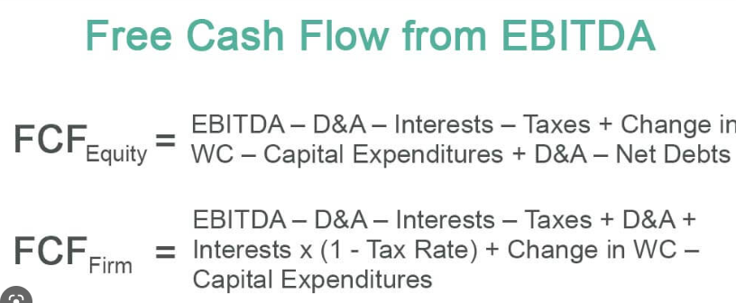
Project Free Cash Flows
Free Cash Flows (FCF) is the cash left over after a company pays for its operating expenses and capital expenditures.
Theoretically, FCF is the cash left to pay off the obligations to the creditors and finally the equity holders, if any.
Got Free Cash Flows from company’s Cash Flow Statements (Yahoo Finance).
Calculate the minimum FCF growth rate to forecast the future FCFs (5 years into the future).

Slide 11
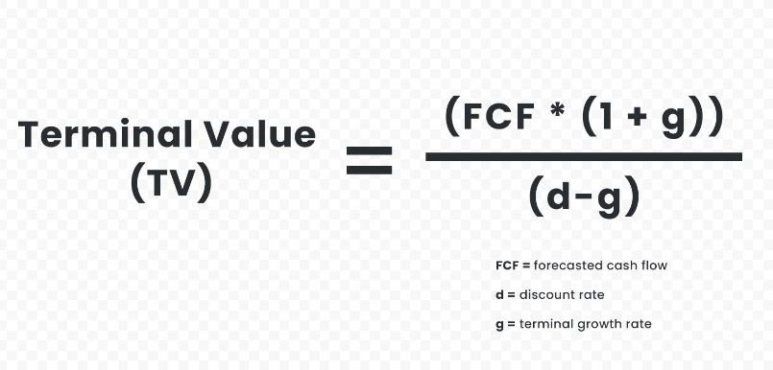
Project Terminal Value
Does the company cease operations after 5 years? Theoretically (and hopefully) NO!
Terminal value calculation assumes that the company will continue to growth perpetually at a constant growth rate (= US Economy’s growth rate)
Using the perpetual growth rate, discount rate (WACC), and the projected cash flow from Year 5, we calculate the Terminal Value.
Add the Terminal Value to Year 5’s projected FCF.

Slide 12
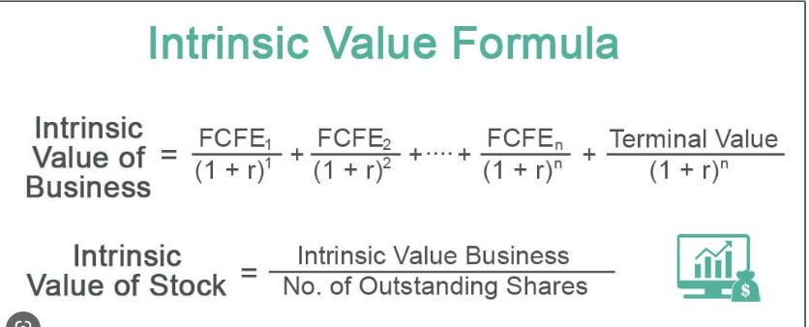
Present Value of projected FCFs and Terminal Value
Use the WACC as the discount rate to find the Present Values of the project cash flows.
Add up all Present Values and divide the sum by the no. of outstanding shares to get the Intrinsic Value of Stock

Slide 13
Caveat!!
Novus Investing’s version of the model:
Sum of Present Values is called the Enterprise Value (since we used Free Cash Flow to the Firm, not Equity)
Equity Value = Enterprise Value + Cash and Equivalents – Total Debt
Intrinsic Value per share = Enterprise Value / No. of outstanding shares

Slide 14
Is DCF modeling a panacea?!?
No! (especially after working on this project).
Includes too many assumptions, especially:
Growth Rate of FCF
Perpetual Growth Rate
We can be conservative in our estimates, but then again this is only an estimate.

Slide 15
Future Considerations
Implement a more robust model for DCF valuation.
Create an application “e-valuator” with robust front-end and backend
DCF model & different flavors
DDM model
Bond valuation
Create an application that includes elements of technical analysis as well

Slide 16
Thank You…

